Slide 1


Day 2: Ledgers, Versions, and Currency
Explain Ledgers, Versions, and Types of Versions

Slide 2

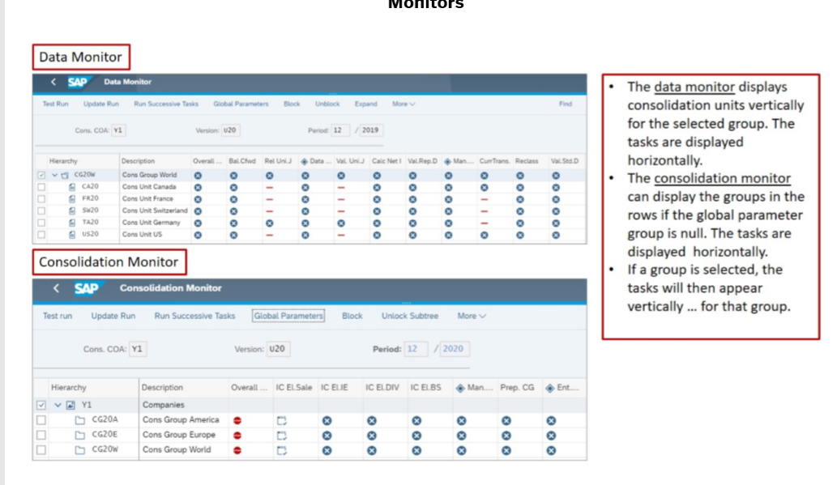

Monitor

Slide 3
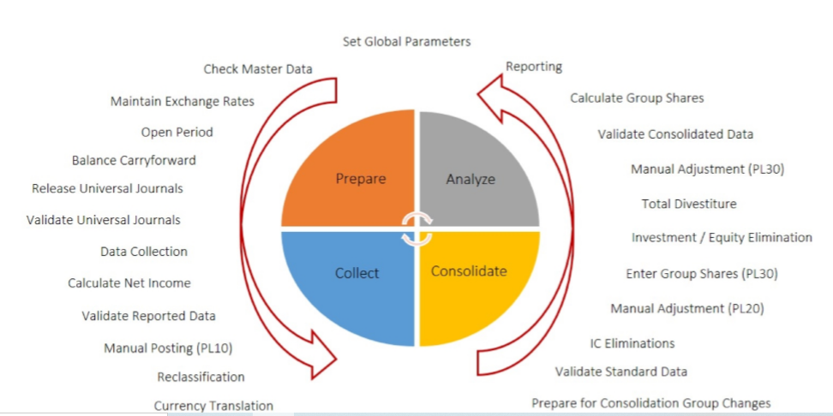
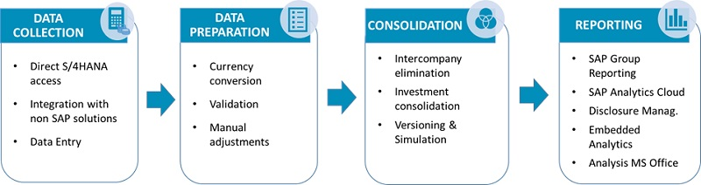
Set Global Parameters

Slide 4
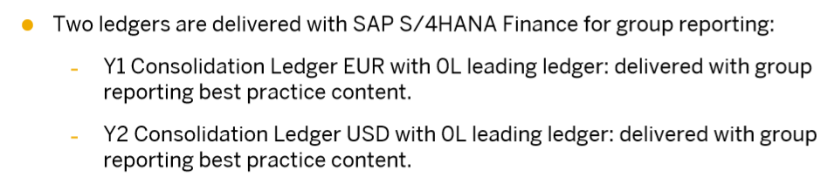
Ledgers

Slide 5
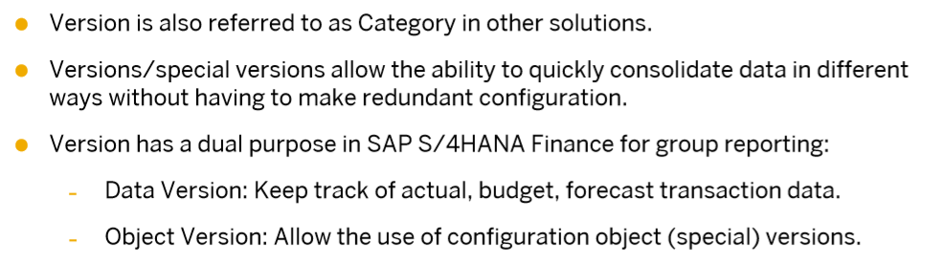
Versions

Slide 6
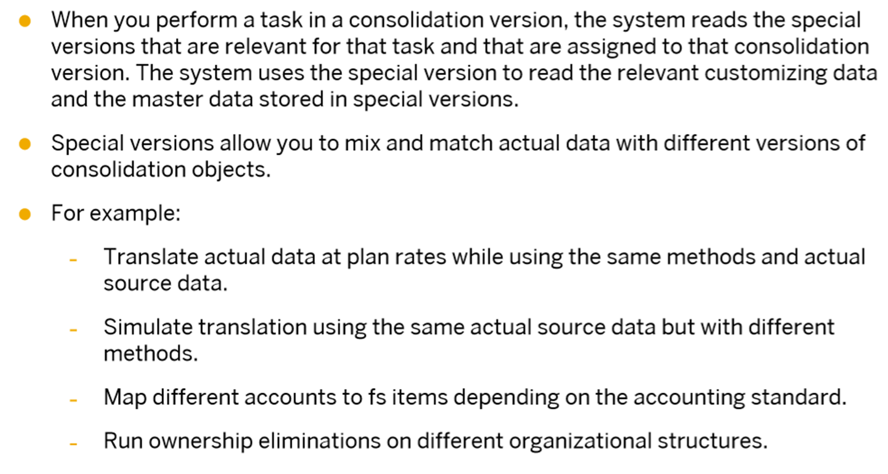
Managing Consolidation Groups and Units

Slide 7
Model Hierarchies for Group Reporting
Data Entry: Enables the use of object versions for the assignment of Data Transfer method/ upload methods and validation methods to consolidation units.
Consolidation Group Attribute: Controls the assignment of the consolidation frequency to the consolidation group.
**Special Version for ‘Cons Group Attributes’. Before FPS1. it was named a special version of “ledger”. And assignment of the cons group to the ledger depends on this special version.
**Since FPS1. it is renamed ‘Cons Group Attribute; It is irrelevant for ledger assignment (since the ledger is removed. If the new group reporting logic is on). But still relevant for the assignment to the cons frequency to cons group.

Slide 8
Structure: Enables the use of a special version for the consolidation group|cosoldation units organizational structure.
Consolidation Unit Attribute: enable version-dependent consolidation unit attributes.
Exchange Rates: enables the use of special versions for the assignment of exchange rates to exchange rate indicators
Reclassification & Eliminations: enables the use of special versions for the assignment of methods and document types to reclassification/elimination tasks.
FS Item Attributes: enables version-dependent FS item Attributes.
Reporting Rules: enables time-dependent assignment of reporting rules to reporting rule variants.
FS Group items: enables the use of object versions for the assignment of FS items to GL accounts. (FS Item Mapping.)

